Slide 1

Odessa State Environmental University

Slide 2
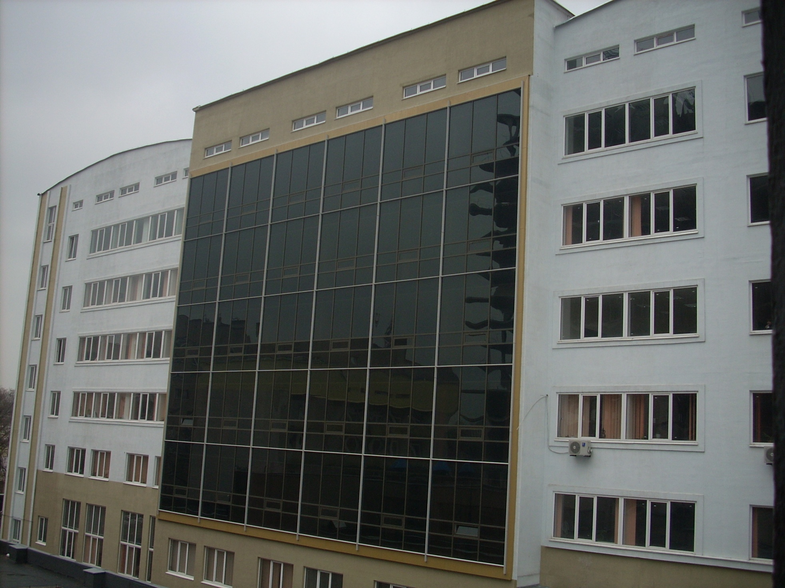
Odessa State Environmental University
Decree of the Cabinet of Ministers of Ukraine № 363-r of 9 August, 2001
“On creation of Odessa State Environmental University on the basis of Odessa Hydrometeorological Institute”
Notes:
Odessa State Environmental University (OSENU) was created by the decree of the Cabinet of Ministers of Ukraine № 363-r of 9 August, 2001 “On creation of Odessa State Environmental University on the basis of Odessa Hydrometeorological Institute”,

Slide 3

Kharkiv Engineering Hydrometeorological Institute
Notes:
which was initially founded in 1932 as the Kharkiv Engineering Hydrometeorological Institute, thus this year OSENU celebrates its 80 anniversary.

Slide 4
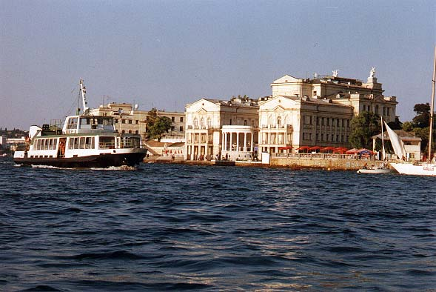
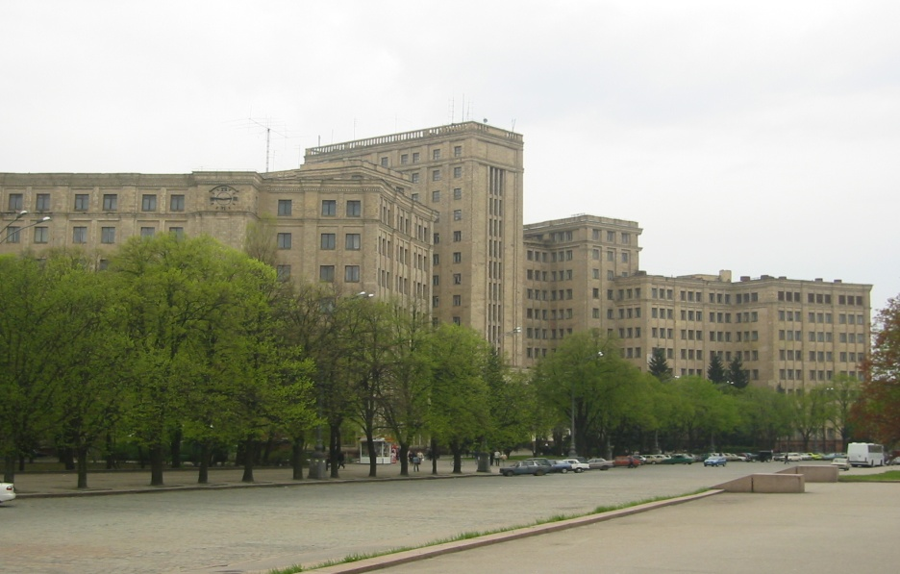
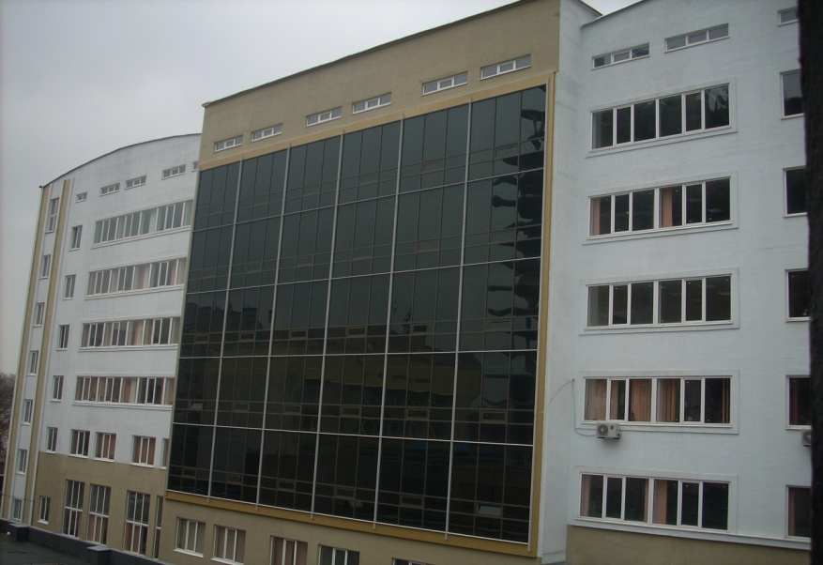
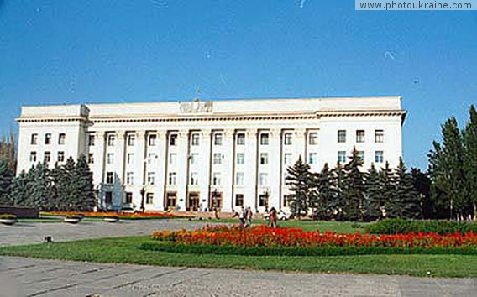
Odessa State Environmental University
Sevastopol
Kharkiv
Odessa
Kherson
Notes:
Odessa State Environmental University is the object of state property and is an affiliated body of the Ministry of Education and Science of Ukraine. It is a multi-campus public university providing innovative undergraduate and graduate education that contributes to development of the society and the individual

Slide 5

Odessa State Environmental University
Notes:
through harmonization of mankind - nature relations. The University actively facilitates learning through preservation, discovery, synthesis, and dissemination of knowledge on the Environment.

Slide 6
Odessa State Environmental University
Key Higher Educational Establishment for
Training of Specialists for
Ministry of
Environmental
Protection of Ukraine
State Committee
of Ukraine of
Water Management
State
Hydrometeorological
Service of Ukraine
Notes:
OSENU is the higher educational establishment of the fourth (highest) level of accreditation in Ukraine, the key higher educational establishment for training of specialists for the Ministry of Environmental Protection of Ukraine, State Hydrometeorological Service of Ukraine and the State Committee of Ukraine of Water Management.

Slide 7
Odessa State Environmental University
Training is provided in
Hydrometeorology
Environmental
Science
Water
Bio-Resources
Computer
Science
Environmental
Management
Notes:
Training is provided in:
"Hydrometeorology",
"Environmental Science",
"Computer Science",
"Environmental Management",
"Water Bio-Resources"
with 14 specialities, including 3 military ones on the instructions of the Ministry of Defense of Ukraine.
Training of specialists is carried out in full-time, extra-mural and externship formats in the fields of:

Slide 8
Full-time, Extra-mural and Externship Formats
Meteorology
Hydrology and Hydrochemistry
Water Management
Hydrometeorology
Oceanography
Hydrography
Agriculture Meteorology
Notes:
- 0706 „Hydrometeorology” (specialities: Meteorology, Hydrology and Hydrochemistry, Water management, Oceanography, Hydrography, Agriculture meteorology);

Slide 9
Full-time, Extra-mural and Externship Formats
Environmental Science
Specialities
Environmental Protection
Environmental Law
Organizing Environmental Monitoring
Hydroecology
Border Environmental Control
Environmental Aspects
of Fish Industry
Radioecology
Environmental Aspects
of Agriculture Production
Environmental Aspects of
Recreational and Health
Resort Economy
Environmental Protection on Nuclear
Power Units and Ionizing
Radiation Sources
Notes:
- 0708 „Environmental Science” (Environmental Protection, Organizing Environmental Monitoring, Border Environmental Control, Radioecology, Hydroecology, Environmental Law, Environmental Aspects of Recreational and Health Resort Economy, Environmental Aspects of Fish Industry, Environmental Aspects of Agriculture Production, Environmental Protection on Nuclear Power Units and Ionizing Radiation Sources);

Slide 10
Full-time, Extra-mural and Externship Formats
Computer Science
Specialities
Information Control Systems and Technologies
Automated Systems of Environmental Quality Monitoring
Geographic Information Systems and Technologies
Notes:
- 0804 „Computer Science” (Information Control Systems and Technologies, Geographic Information Systems and Technologies, Automated Systems of Environmental Quality Monitoring);

Slide 11
Full-time, Extra-mural and Externship Formats
Management
Specialities
Environmental Economics
Environmental Audit
Management of Water Resources
Notes:
- 0502 „Management” (Environmental Economics, Environmental Audit, Management of Water Resources);

Slide 12
Full-time, Extra-mural and Externship Formats
Water Bio-resources
Specialities
Water Bio-resources and Aquiculture
Notes:
- 1303 „Water Bio-resources” (Water Bio-resources and Aquiculture);

Slide 13
Full-time, Extra-mural and Externship Formats
Military Hydrometeorology
Specialities
Provision of Hydrometeorological and Geophysical
Data for the Air Force, the Army, the Artillery
and Rocket Power and the NAVY
Notes:
- 0706 „Military Hydrometeorology” (Provision of Hydrometeorological and Geophysical Data for the Air Force, the Army, the Artillery and Rocket Power and the NAVY) .

Slide 14
Odessa State Environmental University
35 Programs of Short- and Medium Syllabi
for Professional Development
Various Regional
Organizations
and Services
Community
Businesses
Teaching Staff of
Other Universities
Notes:
The University offers thirty-five programs of short- and medium syllabi (twenty-two to one hundred and fifty-four academic hours) for Professional Development in title specialities and specializations for professionals from various regional organizations and services, businesses, teaching staff of other universities and the community

Slide 15
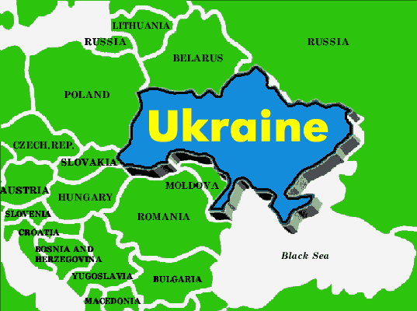
Graduates of the University
Notes:
The graduating students of the University are given assignments form the State Hydrometeorological Service of Ukraine or ones of the CIS countries, regional departments of the Ministry of Environmental Protection of Ukraine,

Slide 16
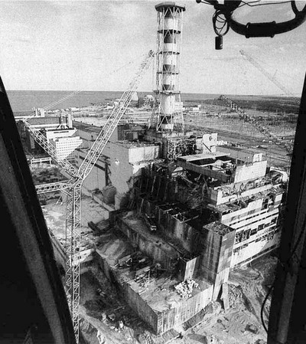
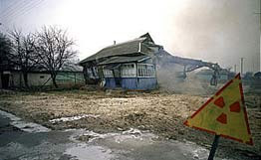

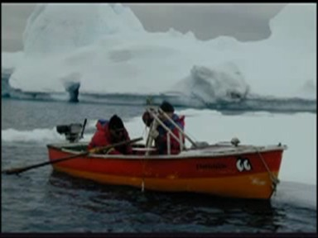
Research Objects
Notes:
the Ministry of Emergencies & Affairs of Population Protection from Consequences of Chornobyl Catastrophe of Ukraine, the State Committee of Ukraine of Water Management, the State Hydrographical Service of Ukraine, the Ministry of Defence of Ukraine, the National Antarctic Scientific Center of Ukraine, other ministries, establishments and departments.

Slide 17

50 years of training specialists for the WMO
Notes:
In the field of „Hydrometeorology” OSENU has been training specialists for the World Meteorological Organization – the specialized agency of the UNO for more than 50 years. The curricula for training specialists in this field meet all international standards and are acknowledged by hydrometeorological services all over the world.

Slide 18
Odessa State Environmental University
Since 1957 the University has provided training for more than 1600 specialists form more than 70 countries
Including Circa 150 Candidates and Doctors of Science
Notes:
Since 1957 the University has provided training for more than 1600 specialists form more than 70 countries, including circa 150 Candidates and Doctors of Science.

Slide 19

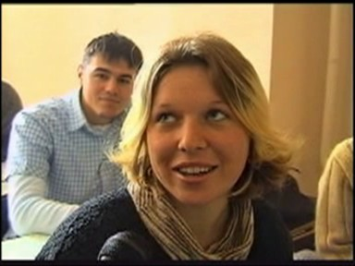
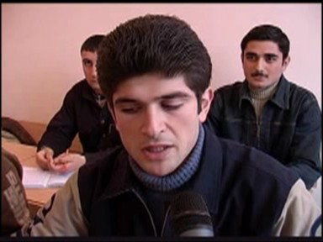
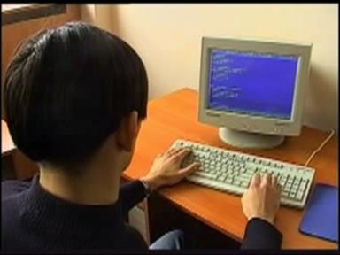
Odessa State Environmental University
Notes:
For the time being foreign citizens of 27 countries have been provided education at the University, including the representatives of all the countries of the former Soviet Union.

Slide 20
University Administration
Division of Studies
Kherson Technical School (College) of Hydrometeorology
Kharkiv Technical School (College) of Hydrometeorology
Faculty of Environmental Control
Faculty of Environmental Science and Economics
Faculty of Computer Sciences
Faculty of Extra-mural Study and Distance Learning
Faculty of Professional Development and Retraining
Preparatory Faculty
Department of Military Training
Department for Foreign Students
Higher School and Science Libraries
Department of Teaching Methods and Systems
Research-and-Training Laboratory of Marine Geophysics
Research-and-Training Laboratory of Meteorology
Research-and-Training Laboratory of Hydroecology.
Laboratory of Educational Technologies
Laboratory of Quality Monitoring for Programmes of Study
Computation Center
Administrative Division
Accounts Department
Economic Planning Department
Personnel Department
Department of Safety of Vital Activities
Admissions Department
Information Systems Department
Foreign Relations Office
Servicing Department
Administrative Support Office
Department on Introduction
of Computer-Aided Systems
Archive
Special Office
Educational department
Department of Graduating
Students’Employment
Department of Capital
Development
Division of Study
Kherson Technical School (College) of Hydrometeorology
Kharkiv Technical School (College) of Hydrometeorology
Faculty of Environmental Control
Faculty of Environmental Science and Economics
Faculty of Computer Sciences
Faculty of Extra-mural Study and Distance Learning
Faculty of Professional Development and Retraining
Preparatory Faculty
Department of Military Training
Department for Foreign Students
Higher School and Science Libraries
Department of Teaching Methods and Systems
Research-and-Training Laboratory of Marine Geophysics
Research-and-Training Laboratory of Meteorology
Research-and-Training Laboratory of Hydroecology.
Laboratory of Educational Technologies
Laboratory of Quality Monitoring for Programmes of Study
Computation Center
Scientific Division
Department of Post-Graduate Study
Scientific-Research Department
Problem Scientific-Reserch Laboratories
Editorial Office
Specialized Scientific Board
for upholding PhD and
DoctoralTheses
Social Division
Hostels (Dormitories)
Canteens
Recreation-and-Sportrs Complex
Notes:
Today OSENU is a powerful academic, training and scientific center which consists of the Hydrometeorological Institute, three full-time faculties – the Faculty of Environmental Science, the Faculty of Environmental and Economic Studies, the Faculty of Computer Science, The Faculty of Master and Post-Graduate Training, The Faculty of Extra-Mural Training, the Faculty of Professional Development and Retraining, Preparatory Faculty, the Department for Foreign Students, Kherson and Kharkiv technical schools of Hydrometeorology, the Center of master's degree training on the basis of the Ocean Center of National Academy of Sciences of Ukraine (Sevastopol), Southern Branch of the State Institute of Professional Development and Retraining of the Ministry of Environmental Protection, research laboratories for advanced study of the Antarctica, of atmospheric air pollution, nuclear and radiation safety, physics of compound systems and the environment.
The Research and Development Department, Specialized Scientific Boards on graduation of a scientific degree of Doctor of Science and Candidate of Science (Ph.D.) in 4 scientific specialities, graduate school and doctorate study course in 8 specialities are highly operative.

Slide 21
Teaching Staff
Various Academic
Degrees and Grades
78%
19%
Doctors of Science,
Professors and Academicians
Notes:
Tuition for more than 4500 students is provided by 272 teachers, among which more than 78% enjoy various academic degrees and grades, including 19% of Doctors of Science, Professors and Academicians.

Slide 22
Scientific-Research Staff
Hydrometeorology
Environmental Control
Environmental Management
Notes:
The University is proud of its scientific staff, which is the most potent in Ukraine, in the fields of Hydrometeorology, Environmental Management and Environmental Control.

Slide 23
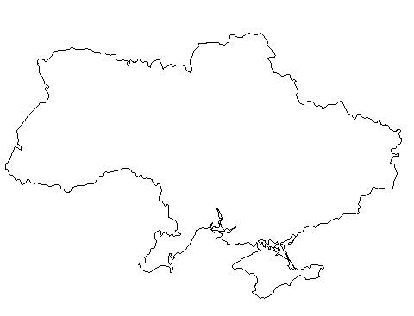
Odessa State Environmental University
Scientists of the University made ponderable
contribution to development of Hydrometeorological
Science in Ukraine
Notes:
Scientists of the University made ponderable contribution to development of Hydrometeorological Science in Ukraine. Scientific-research works of the teachers and research workers of the University were awarded

Slide 24


OSENU Awards
Notes:
the Prize of the Council of Ministers of the USSR, medals and diplomas of the Exhibition of Achievements of National Economy of the former USSR, various rewards of independent Ukraine. As a result of the activity the University is annually included in the list of the three best higher educational institutions of the Odessa region and the Ministry of Science and Education of Ukraine rated it as the best in its Sectoral Group of Higher Educational institutions.In 2002 by the results of the International Academic Rating ‘Golden
Fortune’ the University was awarded the Silver Medal ‘10 years of Independence of Ukraine’, the same year the University was declared the laureate of the International Contest ‘Golden Trade Marks 2004”.

Slide 25
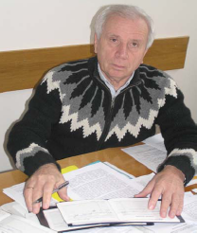
Scientific Schools
Theoretical and Applied Hydrology
Notes:
At Odessa State Environmental University the following scientific schools have been designated:
Theoretical and Applied Hydrology (founders – Anatoliy Mikolaiovitch Befani - a world-renowned scientist, Doctor of Science (Engineering), Professor and his successors Eugen Dmytrovitch Gopchenko – Doctor of Science (Geography), Professor and Alexander Grygorovitch Ivanenko - Doctor of Science (Geography), Professor)

Slide 26
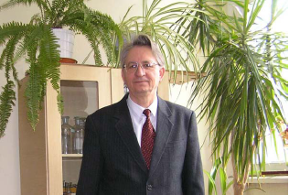
Scientific Schools
Simulation of Crop Productive Processes
Notes:
Simulation of Crop Productive Processes (founder – Anatoliy Mykolaiovitch Polevoy - doctor of Doctor of Science (Geography), Professor );

Slide 27
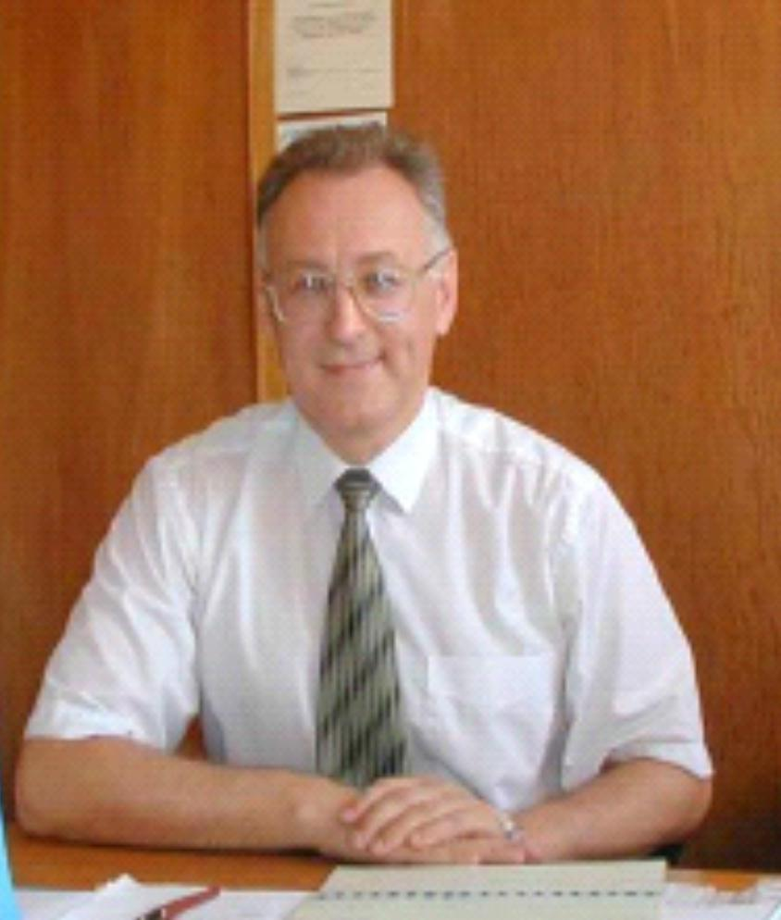
Scientific Schools
Fundamental and Applied Research into the Boundary Geophysical Layer
Notes:
Fundamental and Applied Research into the Boundary Geophysical Layer (founder - Wolf Abramovitch Schnaidman - Doctor of Science (Physics and Mathematics), Professor and his colleagues: Anatoliy Grygorovitch Tarnopolskiy - Doctor of Science (Geography), Professor and Sergiy Mykolaiovitch Stepanenko - Doctor of Science (Physics and Mathematics), Professor).

Slide 28
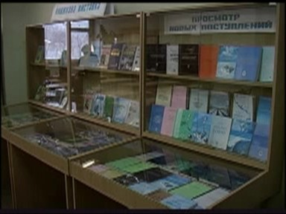
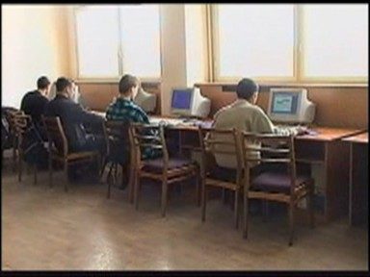
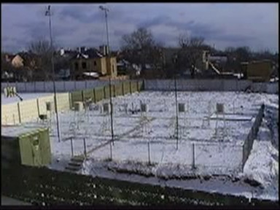
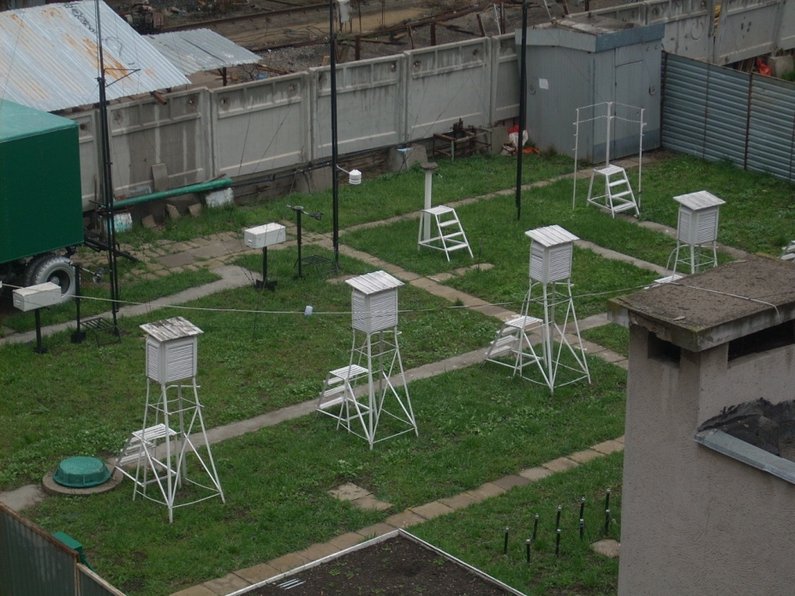
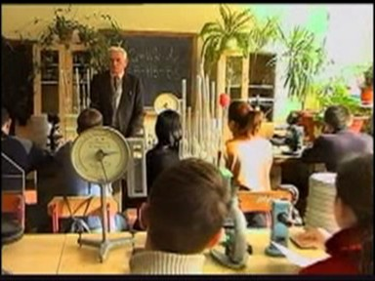
Odessa State Environmental University
Notes:
Odessa State Environmental University has four buildings, 3 research-and-training laboratories, computer center, three scientific research laboratories, two student dormitories, and a student sports and health-improving camp with the total floor area of 46553 m2, including 26689 m2 of study-rooms, research-and-training and training laboratories.

Slide 29
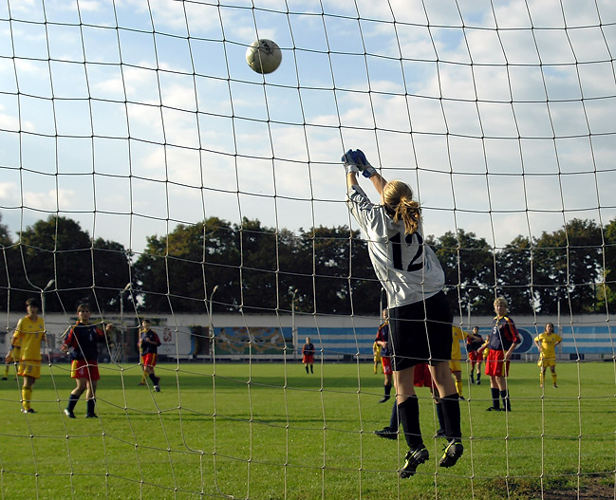
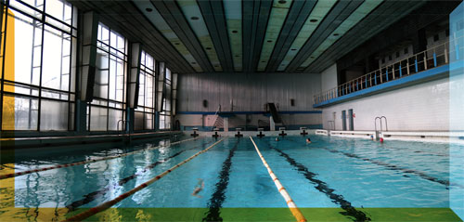
Odessa State Environmental University
Notes:
The University has 2 cafeterias, a canteen, a first-aid station and a student preventive clinic, where the students and University personnel could recondition. Training and coaching of the students is provided in various sports groups at the Sports Complex which has an up-to-date swimming pool and all other modern sports facilities to hold various kinds of activities and competitions.

Slide 30
INTERNATIONAL COLLABORATIVE ACTIVITIES IN THE FIELD OF RESEARCH
Agreements on collaborative efforts in the field of research with 29 foreign research instutions and universities.
The university is a member of Asia Pacific Applied Science Associates (APASA), Alliance of Universities for Democracy (AUDEM), European Cooperation in Science and Technology (COST), Euroasian Universities Association (EAU), Black Sea Universities Network (BSUN).
Prof. Oleg I. Gerasimov was awarded the highest order of the Kingdom of Belgium for foreign citizens – the rank of Commander of Ordre de la Couronne (Belgium).
9 International research projects have been performed under individual grants.

Slide 31
Thank You !

